Slide 1
Corrosion Lecture
We’ve been discussing fundamental, useful properties of matter
This lecture:
• Corrosion Properties of matter
Useful aspect of matter in use
Quarter trillion $ cost to US in 2001

Slide 2
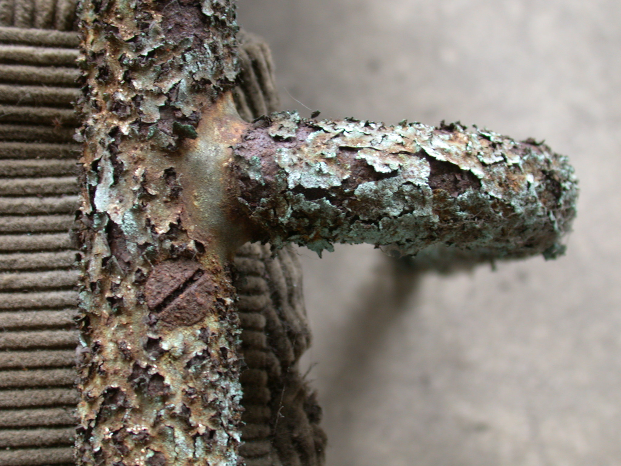
- Imageafter photo

Slide 3

Imaged (using Prussian Blue indicator) iron ions flowing
From iron nails sitting in a wet environment.
- Univ of West Indies photo

Slide 4
Corrosion of metals is generally an
Electrochemical process, meaning that
Electrons are flowing from somewhere
(often the metal) to someplace else
(most commonly to oxygen or acid)
WHY?
Well, we live in an oxidizing atmosphere,
And the reaction of many metals with oxygen
To form metal oxides is thermodynamically
Favorable under earth conditions (ΔG<0)

Slide 5
If you go to Table 16.1 in Callister, you will
Find a list of standard “half cell” potentials
For example,
Zn²+ + 2e⁻ → Zn -0.763 V
H⁺ + e⁻ → ½ H2 0.000 V
Combining
Zn + 2H+ → Zn2+ + H2 net +0.763 V
(reverse of first eqn plus 2x the second)

Slide 6
Zn + 2H+ → Zn2+ + H2 net +0.763 V
ΔE⁰ = + 0.763
This standard potential is related to the Gibbs
Free energy by the Nernst Equation
ΔG⁰ = -nFΔEº where F is the Faraday Constant
= 96,485 C/mol and n = # electrons
So note, negative Gibbs energy and positive standard
Potential reactions are favorable!

Slide 7
Go to chalkboard
Favorable plating?
Equilibrium (LaChatliere’s effects)
Multiple electronics

Slide 8
This is highly favored thermodynamically under normal
conditions, Driven by the high enthalpy of formation of iron oxide
Fe(II) in turn comes from Fe metal and oxygen or acid

Slide 9
Let’s consider corrosion of a zinc surface by acid
There are several steps associated with this process:
1. H+ diffuses to the metal surface
2. an electron is transferred from metal to H+ to
produce H. , that is a hydrogen atom
3. Two hydrogen atoms combine to produce H₂
4. Hydrogen molecules coalesce to produce a bubble
5. Eventually the bubble bursts and gas escapes
Which step is slowest depends on specific conditions,
And will determine the overall rate (“rate determining
Step”)

Slide 10
By the way, not all electochemical reactions are bad news
e
A
e
Anode
Cathode
H⁺
H⁺
O₂
H₂
H⁺
H⁺
1/2O₂ + 2H⁺ + 2e → H₂O
H₂→ 2H⁺ + 2e
H⁺
H₂O
H⁺
Catalytic Layer
Polymer Electrolyte Membrane (PEM)

Slide 11
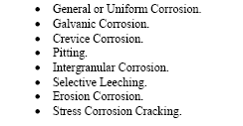
8 visual categories of corrosion
University of Alaska

Slide 12
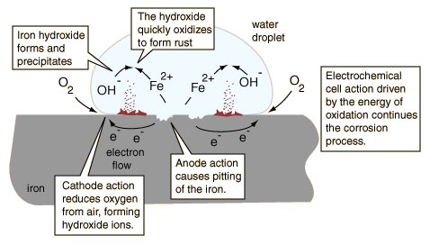
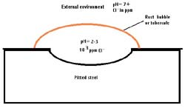
Pitting
Simon Frasier University
pH is lower, and Cl- is higher inside internal environment
- NASA

Slide 13
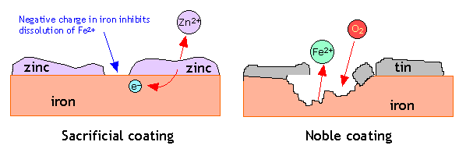
Tin can vs Galvanize can. If moisture and air come in contact
With iron in the tin can, electrons will flow rapidly through the
Tin layer, expediting the oxidation process (rusts). In the
Galvanized can, the zinc is preferentially oxidizes, leaving the
Iron in good shape.
Simon Frasier University diagram

Slide 14
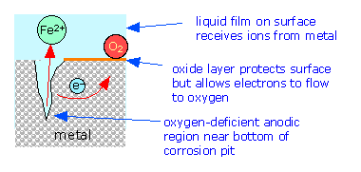
Crevice corrosion
Simon Frasier University

Slide 15
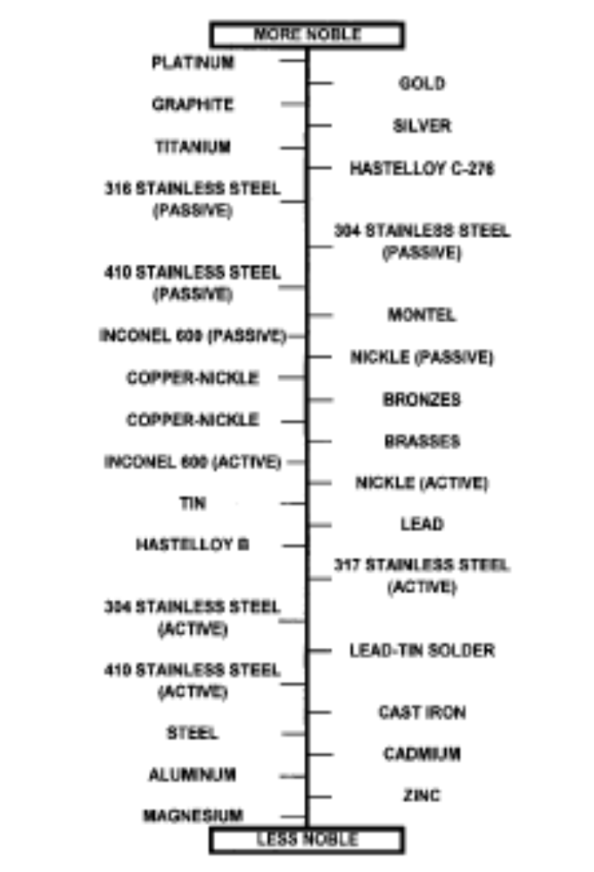
The Galvanic Scale

Slide 16
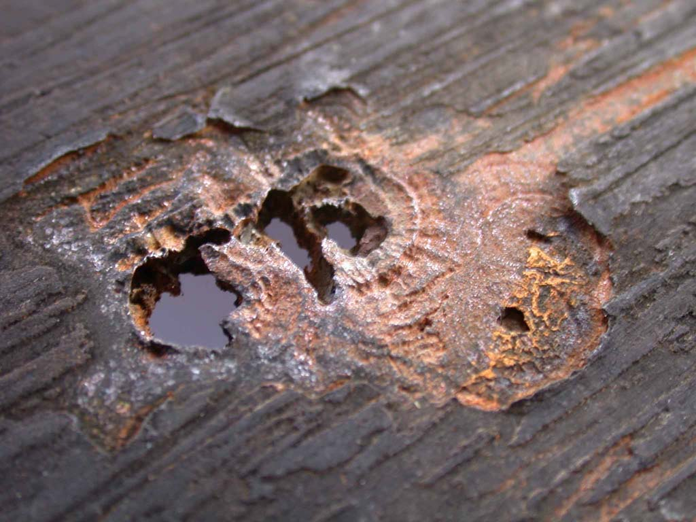
Bacterial corrosion of a metal surface

Slide 17
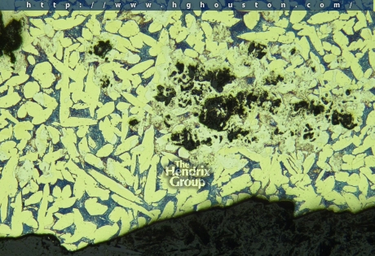
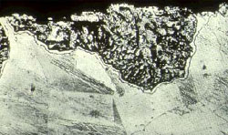
Selective leaching
Loss of Al from a Ni/Al Impeller Loss of Zinc from brass, leaving
used in a water treatment plant only copper behind (- NASA)

Slide 18

Chloride stress cracking, 316 ss, 400 ppm Cl- water in heat exchanger

Slide 19
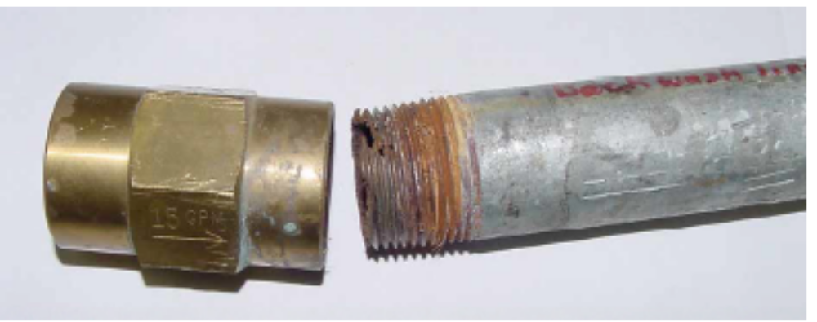
Brass fitting + steel plumbing pipe
Set of photos from Univ of Alaska

Slide 20
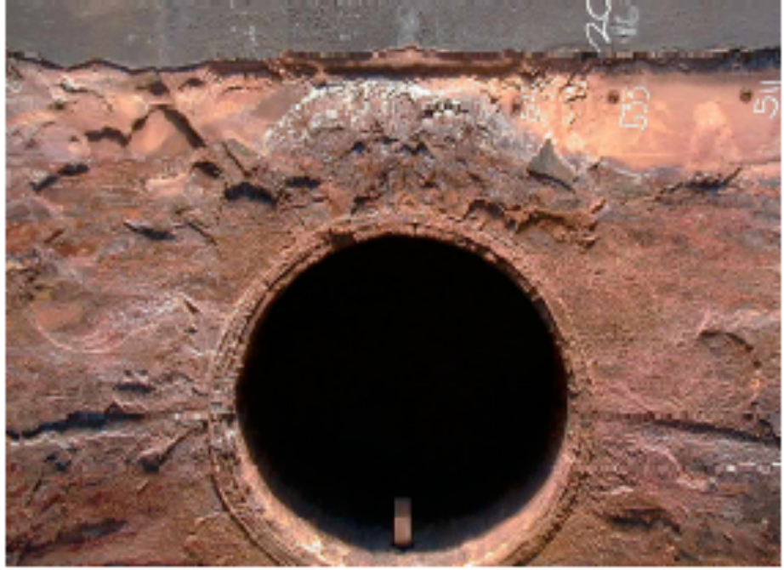
Erosion around heat exchanger nozzle
Why do so many examples involved heat exchangers?

Slide 21
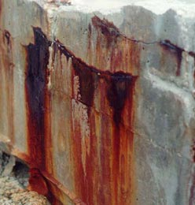
Rusty iron rebar in concrete at the Kennedy Space Center
Resulting from salt water spray - NASA photo

Slide 22
While most corrosions are thought of as
Oxidative failures, the presence of hydrogen
Can also “corrode” metals and alloys in a process
Referred to as hydrogen embrittlement
Hydrogen gas can be converted into hydrogen atoms
in a metal matrix (not very favorable, so long term
Exposure is generally needed)
These “H-dots” can react to create new metal species
(hydrides, for example) and can lead to massive
Mechanical failures when stress is applied

Slide 23
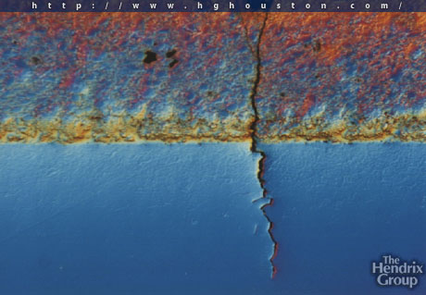
Wed
Hydrogen embrittlement of stainless steel

Slide 24
And what about ceramics and polymers?
Ceramics are generally oxidized metallic species,
And therefore are rather resistant to additional
Oxidations (and tend to be stable at typical
Operating temps, and therefore not easily reduced
Either). Keep in mind that ceramics are often
Produced at 500-1500°C, and therefore may need
A lot of energy Imported to bring about
transformations

Slide 25
And what about ceramics and polymers?
Polymers, being carbon based in most cases,
Tend not to oxidize/chemically corrode in the
Same “redox” manner as metals
Polymer functional groups (the esters in polyesters,
For example) can be excited by light and can react,
Leading ultimately to C-C bond breaking and loss
Of molecular weight. Most environmental damage
Mechanisms to polymers manifest themselves as
Loss of molecular weight and ultimately then loss of
Ductility and toughness (embrittlement)

Slide 26
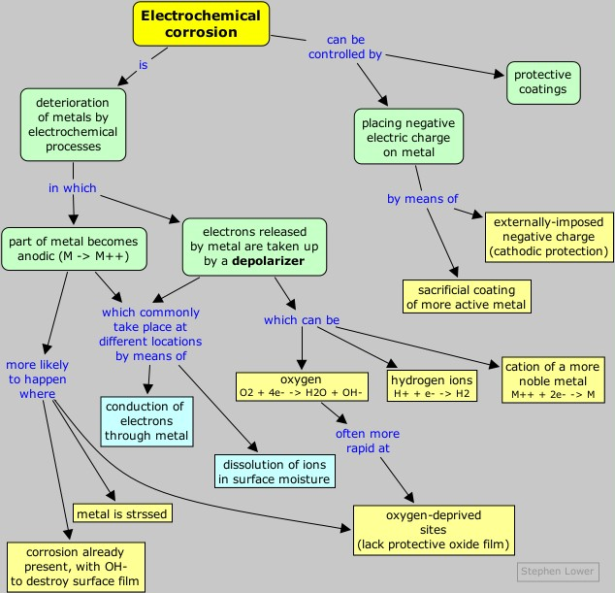
Simon Frasier University

